Slide 1

BANNERGHATTA

Slide 2
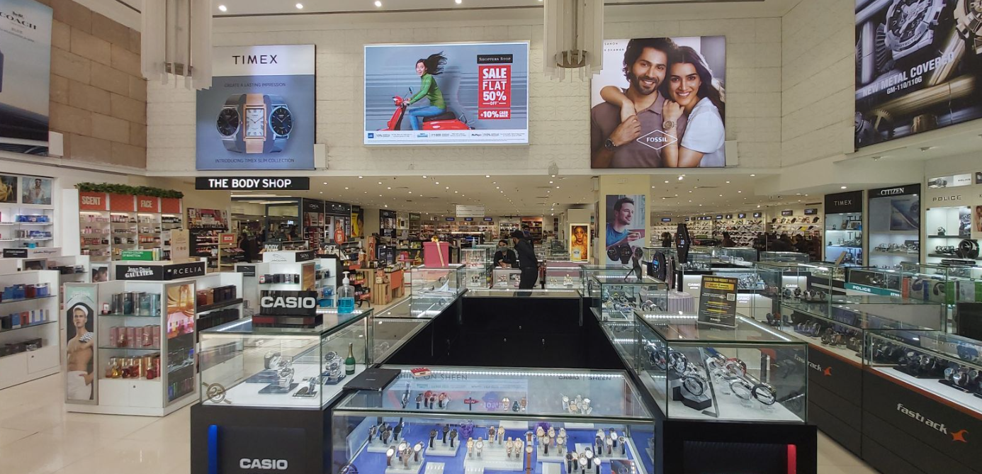
Bang 2 | 16DSO1 |  |  | LED

Slide 3
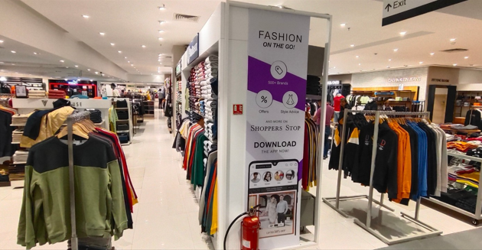
Bang 2 | 16V27

Slide 4
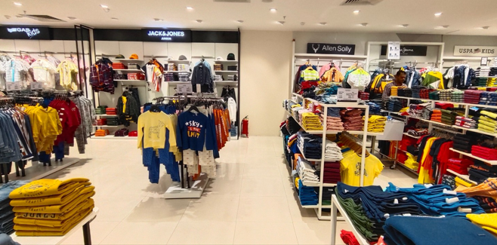
Extra 1

Slide 5
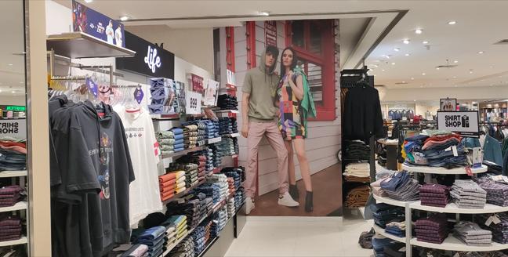
Bang 2 | 16v28

Slide 6
